Slide 1
Human Data Analytics A.Y. 2022/2023
Final Project: Lymphoma Subtype Classification
Gianpietro Nicoletti 2053042¹ , Stefano Campagnola 2058080²
¹Department of Information Engineering, ICT for Internet and Multimedia, University of Padua
²Department of Physics and Astronomy, Physics of Data, University of Padua

Slide 2
What is Lymphoma?
Lymphoma is a type of cancer that affects the lymphatic system
Digital pathology involves the capture, storage, sharing, and analysis of high-resolution images of microscopic slides
Relation between the two: digital pathology has a significant impact on the diagnosis, consultation, research, and overall management of lymphoma

Slide 3
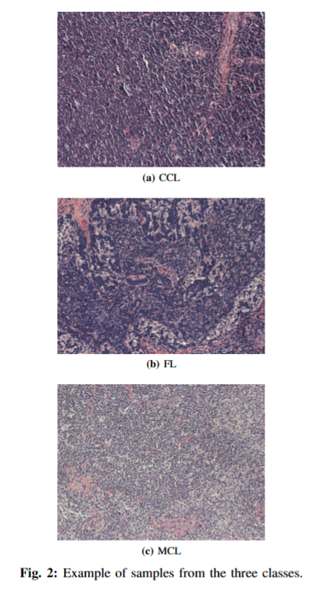
Dataset
374 RGB images from the National Institute of Ageing (NIA) of size 1388x1040
Three classes:
Chronic lymphocytic leukaemia (CLL)
Follicular lymphoma (FL)
Mantle cell lymphoma (MCL)
Train/validation/test splitting:
70% train
10% validation
20% test

Slide 4
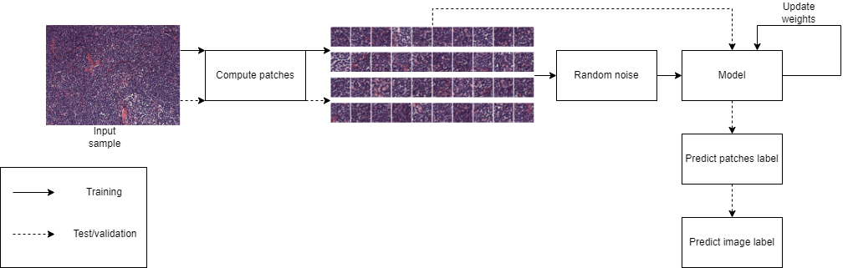
Pipeline

Slide 5
Data preprocessing
Each image is split in 40 patches of size 128x128
Random noise is added only to the train patches
Label of the patches same of the source image
Label smoothing
Image RGB channels rescaled to [0,1]

Slide 6
Self-supervised learning
Self-supervised learning is a machine learning technique in which a model learns to extract meaningful representations or features from unlabelled data
Pretext task is a side objective of the model that guides the achievement of the main task:
Pretext task → image reconstruction
Main task → image classification
In our case image reconstruction task will help to construct a better latent representation in our autoencoder model

Slide 7
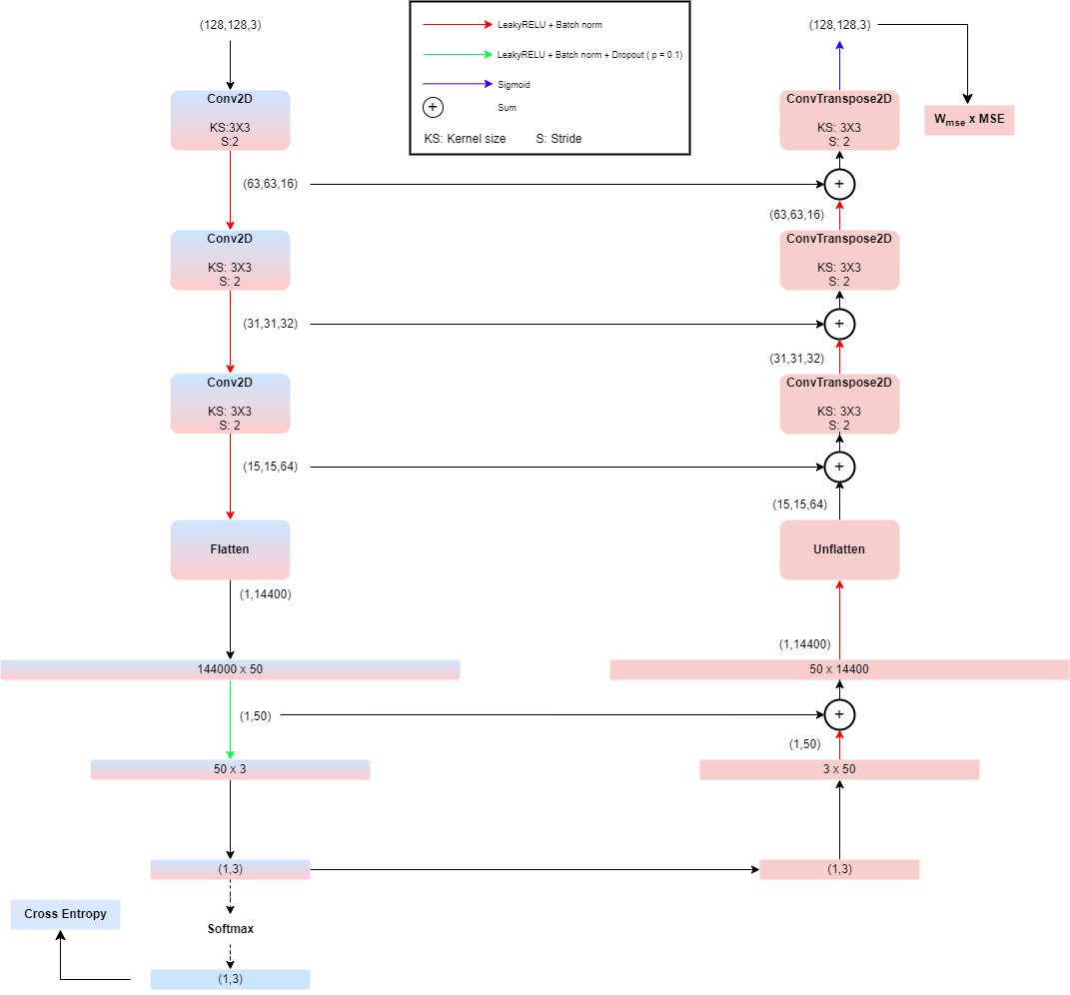
Architecture
Classifier includes the encoder part + softmax
Autoencoder is encoder + decoder + sigmoid
Skip connections inspired by U-net

Slide 8
Thank you for your attention

